Slide 1
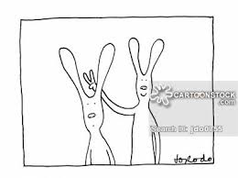
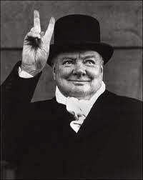
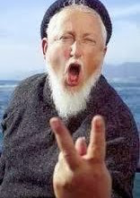
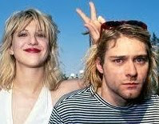
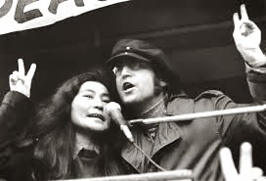
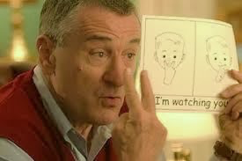
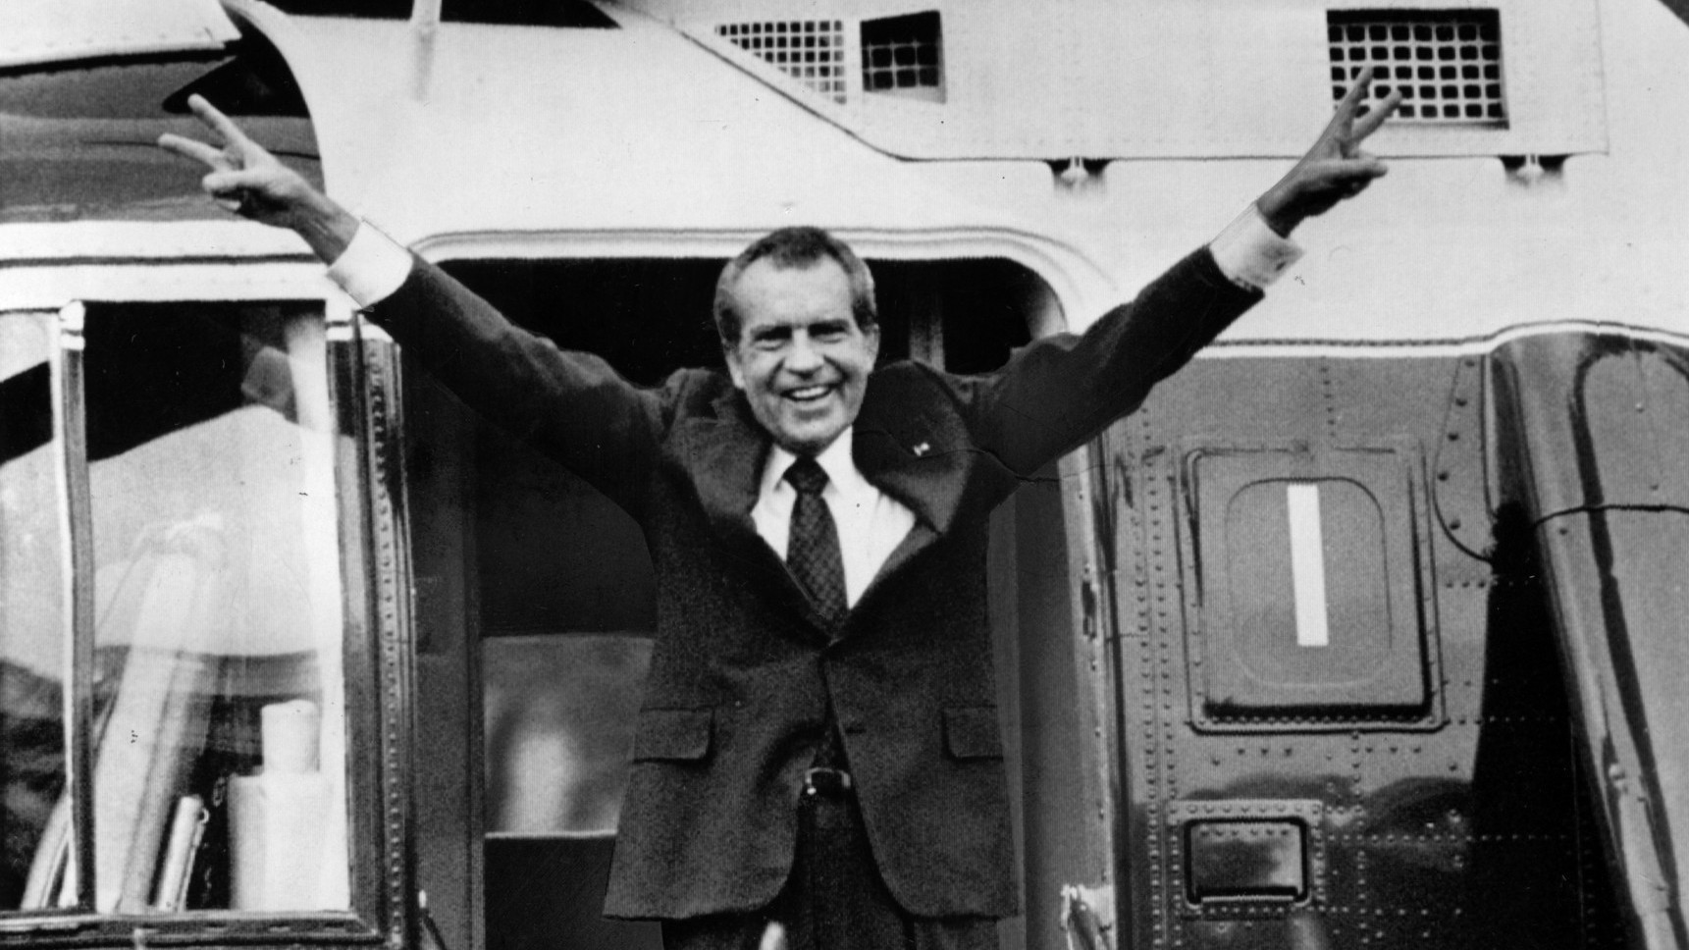
Pastor Gary Hart
Date: 6-26-16
Text: Neh.7:1-5
Intro:“V”is a sign for“rabbit ears”, “victory”, “peace”, “obscene”, “I am watching you”, victory (won) and vigilance (watchfulness).
Title:“V” is for Victory+Vigilance.
1. Victory (7:1a) — “After the wall had been rebuilt…”
A. The impossible done. God’s vision and work completed in 52 days (6:15).
B. The enemy defeated. Nehemiah tells of attacks from outside (ch.4), attacks from within (ch.5), and personal attacks (ch.6). “Victory in Jesus.” In Neh.1-6 the people existed for the walls,7-13 the walls existed for the people. You don’t go to church, you are the church.
(1)

Slide 2
2. Vigilance (7:1b-73)—“Having done all, to stand”(Eph.6:13) to protect the people and the work. 3 important steps to take:
A. Enlisting Leadership (7:1-3) Leaders+Leaders-In-Training.
(1) Nehemiah (v.1)—God called him to be a leader and gave him a vision for the work.
(a) He gave the people hope (2:18-20).
(b) He prayed for the people that God would strengthen them.
(c) He stood for the people against the enemies.
(2) Assistants (v.2)—He needed to appoint+train other leaders.
(a) Their calling. Hanani (1:2;7:2) his brother was in charge of the city. Hananiah (2:8; 7:2) was commander of the citadel. Rephaiah (3:9), and Shallum (3:12).
(b) Their qualifications. They were faithful to God (men of integrity). The greatest ability is dependability (Bob Jones Sr.). They feared God. When leaders fear people instead of fearing God, they end up getting trapped and that leads to failure.
(2)

Slide 3
(3) Gatekeepers (v.1,3a). What good are strong new gates if nobody is guarding them and controlling who enters and leaves the city? The Great Wall of China was penetrated by the enemy at least four times, and each time the guards were bribed. Gates and walls are only as good as the people who guard them. To open or close and lock the gates without the guards on duty might give enemy agents opportunity to slip in unnoticed.
(4) Guards (v.3b). There were 2 kinds of guards (“watches”): those to patrol the walls at specific stations and those to keep watch near their own houses. There were watchmen on the walls and “neighborhood watch.” If God’s people don’t protect what they have accomplished for the Lord, the Enemy will come in and take it over. Every Christian ministry is one generation away from destruction, and God’s people must be on guard. Christian parents need to guard their homes. Christian leaders need to guard churches & schools.
(3)

Slide 4
B. Establishing Citizenship(7:4-69;Ez.2:1-64) Those people were God’s “bridge” from the past to the future (Heb.11).
10 groups are mentioned.
(1) Leaders who returned with Zerubbabel (7:7).
(2) Various families or clans (7:8-25).
(3) People according to their villages (7:26-38).
(4) Priests (7:39-42).
(5) Levites (7:43).
(6) Temple musicians (7:44).
(7) Temple gatekeepers (7:45).
(8) Temple servants (7:46-60).
(9) No genealogies (7:61-65).
(10) Miscellaneous groups (v.66-67) and animals (v.68-69).
They were “pioneers of faith” who trusted God to enable them to do the impossible.
Is your name in the Book of Life?
(4)
(2)

Slide 5
C. Encouraging Worship(7:70-73) Worth of the individual depends on his/her relationship to God, this involves worship.
(1) They gave generously to the temple ministry (7:1-72).
(2) God appointed ministers at the temple: priests, Levites, singers, and helpers.
How to apply: Important lessons can be learned.
A. People are important to God. God used common people who were willing to risk their futures on the promises of God.
B. God keeps accounts of His servants. He knows where we came from, what family we belong to, how much we gave, and how much we did for Him. When we stand before the Lord, we will have to give an accounting of our lives before we can receive our rewards (Ro.14:7-12), and we want to be able to give a good account.
C. God is able to keep His work going. God buries His workers but continues His work.
(5)
(2)

Slide 6
D. We must all make sure that we know we are in the family of God. If you are not sure of your spiritual genealogy, look at Jn.3:1-18 and I John 5:5-13 and make sure that your name is written down in heaven (Lk.10:20).
These principles apply for the church and for the home.
Conclusion: What began with concern (Neh.1), led to construction (Neh.2-3) and conflict (Neh.4-6), now it was time for consecration (Neh.7-12). As we serve the Lord, we must always do your best, but without His help and blessing even our best work will never last. “Unless the Lord builds the house, the builders labor in vain. Unless the Lord watches over the city, the guards stand watch in vain.” (Ps. 127:1). Nehemiah knew that there was a desperate need for the people to come back to the Lord and turn away from their secret sins that were grieving Him.
(6)

Slide 7
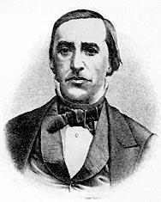
On Tuesday, April 13th, 1858, the sleeve of Dudley Tyng
got caught in the cogs of a machine, and his arm was
severely injured.The arm was soon amputated,the wound became mortal,and Tyng died the following week. Before he died, however, he was asked by friends if there were any mes-sages he would have them give to those who had participated with him in the revival work. Tyng responded briefly, begin-ning with the words,“Tell them,‘Let us all stand up for Jesus.’” In the days and events following Tyng’s death, these final words were invoked several times and became a resounding exhortation to all who had been affected by his ministry. When George Duffield, Jr. preached to his own congregation the next week, he focused on Ephesians 6:14 (“Stand therefore, having fastened on the belt of truth…”) and concluded his sermon with a hymn he had written. It began with the line, “Stand up, stand up for Jesus.” Let’s us stand and sing this hymn.
(2)
(7)

