Slide 1
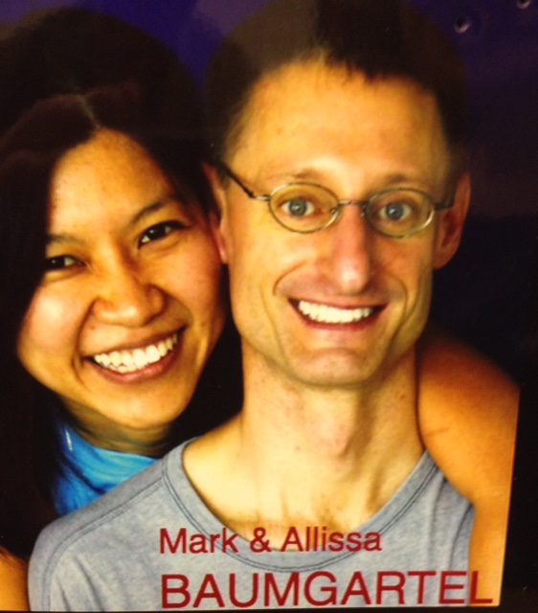

Slide 4
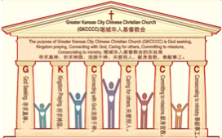
主日:二零一七年八月二十日
Sunday: August 20, 2017
何礼义牧师 Pastor Gary Hart
题目：“祷告的教会。”
Topic: “Praying Church.”
经文:徒16:12-34 Text: Acts 16:12-34
“我们知道那里有一个祷告的地方…”
(徒16:13)。
“We expect to find a place of prayer…”(16:13).
(1)

Slide 5
引言:A。使徒行传的信息。 Intro: A.Message of Acts of the Apostles.
(2)
(一)基督建造祂的教会（基督的灵借着使徒在作工）。
(二)使徒行传是圣灵的指挥,控制和赋权的事工,创立和加强了教会，
并使它成长。
(三)使徒行传是一个过渡时期:从耶稣的事工到使徒的;从旧约到新约;从以色列作神的见证到教会作神的见证;从犹太教出来, 教会诞生了。
(四)使徒行传显示大使命得以遵行(1:8)从见证人到耶路撒冷(1-8),到
犹太和撒玛利亚(8-12)并到地极(13-28)。
(五)保罗继续了他的第二次宣教旅程。
(1)Christ builds His Church(the Acts of the Spirit of Christ through the Apostles). (2)The Acts were the Spirit’s directing, controlling, and empowering ministry that founded and strengthened the church and caused it to grow.
(3)The Acts is a time of transitions: from ministry of Jesus to that of the apostles; from the Old Covenant to the New Covenant; from Israel as God’s witness to the Church as God’s witness; from Judaism is going out and Church is coming in.
(4)The Acts show the fulfillment of the Great Commission(1:8) from the witness to Jerusalem(1-8), to Judea and Samaria(8-12), and to the ends of earth(13-28).
(5) Paul continues his second missionary journey.

Slide 6
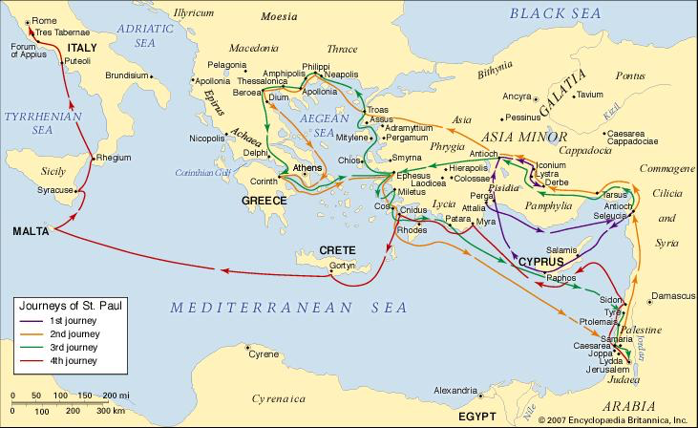
B。腓立比地理位置。B. Philippi location.
(3)

Slide 7
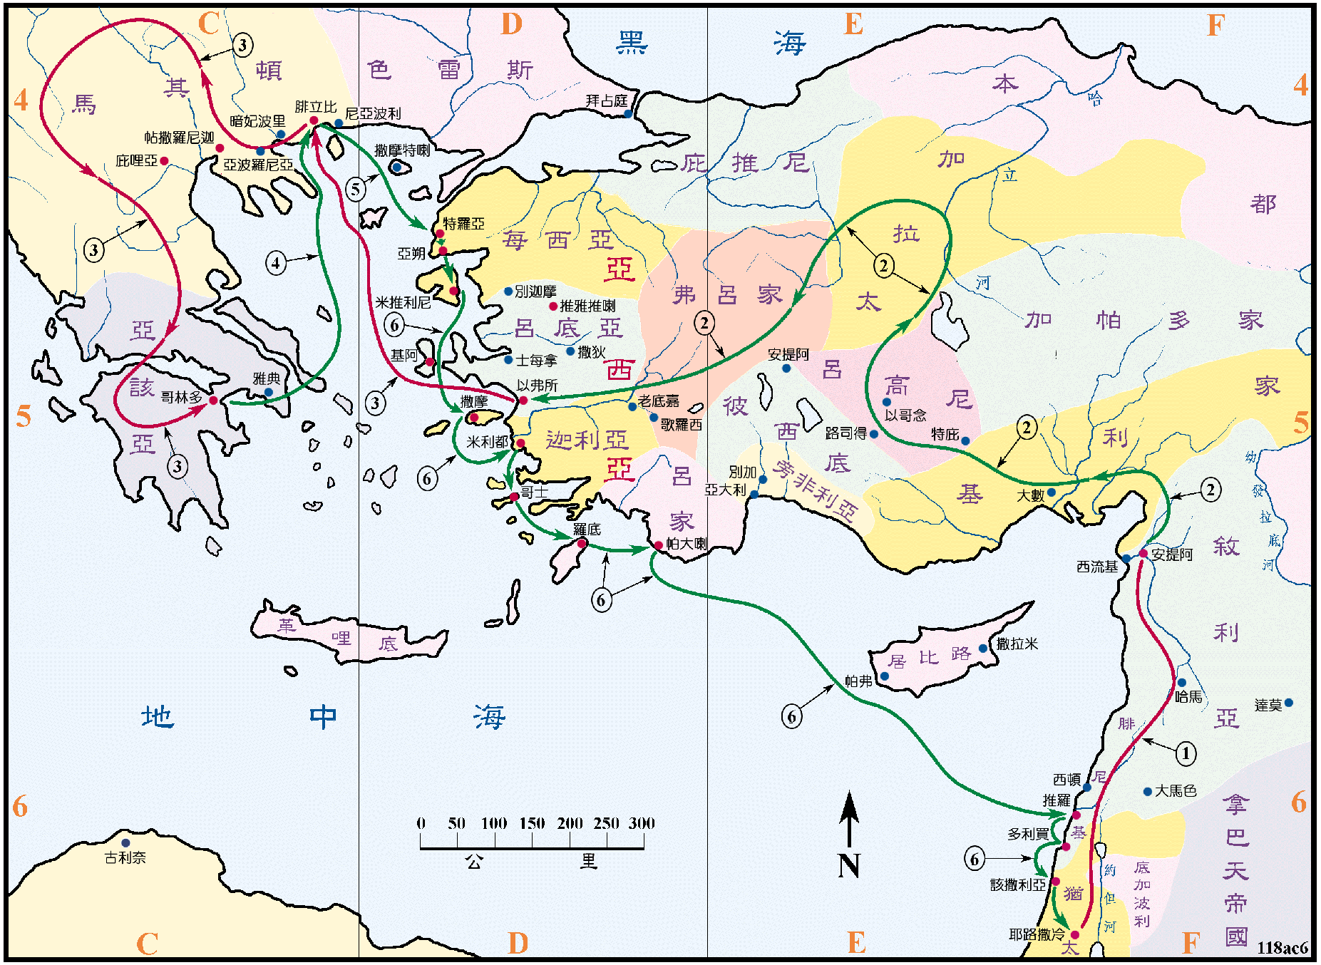
B。腓立比地理位置。B. Philippi location.
(4)

Slide 8
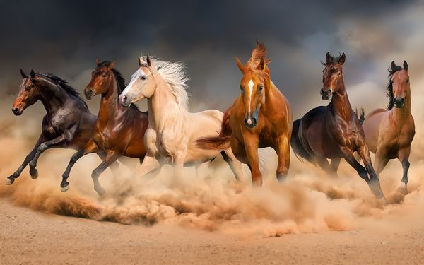
C。腓立比的历史背景。C.Philippi historical background.
(5)
(1)腓立比是马其顿东北部的城市，以亚历山大大帝的父亲腓利二世为名。 “从那里来到腓立比，就是马其顿这一方的头一个城。也是罗马的驻防城”（16:12）。
(2)腓立比教会是由保罗创立的（16:12;腓1:1）。
(3)腓立比教会代表“祷告的教会”。
(4)腓立比来自“腓利”意思是“喜欢马”。 马是强大的动物。(1)Philippi was a city in NE Macedonia named after Philip II, father of Alexander the Great. “From there we traveled to Philippi, a Roman colony and the leading city of that district of Macedonia. And we stayed there several days”(16:12).
(2) Philippi church was founded by Paul(16:12;Phil.1:1).
(3) Philippi church represents “Praying Church”.
(4) Philippi comes from “Philip” which means
“fond of horses”. Horses are powerful animals.

Slide 9
C。腓立比的历史背景。C.Philippi historical background.
(6)
祷告是强大的（雅5:16）。 什么是祷告？ 祷告呼求耶和华的名（创4:26; 12:8）。 你喜欢祷告吗？ 从腓立比教会我们学习祷告的地方，祷告的时间，祷告的人，祷告的元素，和祷告的应许。
Prayer is powerful(Jam.5:16). What is prayer? Prayer is calling on the name of the Lord(Gen.4:26;12:8). Are you fond of prayer? From Philippi Church we learn about praying places, praying times, praying people, praying elements, and praying promises.
更多的祷告更多的能力。
减少祷告
减少能力。
没有祷告
没有能力。

Slide 10
(7)
一。祷告的地方。1. Praying places.
“当安息日，我们去…那里有一个祷告的地方”(16:13)。
A。公开祷告。在各个公共场合一起祷告(太18:20)。 (1)在祷告的殿。 “因我的殿必称为万民祷告的殿”(赛56:7; 可11:17)。圣殿(王下19:14)，教会(徒4:23-24,31;12:5)和家(10:1-2)都可以成为祷告的殿。 (2) 在城外的河边。“我们出城门，到了河边，知道那里有一个祷告的地方”(16:13b;16a)。腓立比的犹太人口一定非常少，因为那里没有犹太教会堂。 （需要十个男人才能建立犹太教会堂。）他们在加格斯河边相遇。 (3) 在监狱(16:25a)。
“On the Sabbath we went…where we expected to find a place of prayer”(16:13).
A. Public praying. Pray together in various public places(Mt.18:20). (1) At the house of prayer. “For my house will be called a house of prayer for all nations”
(Isa.56:7;Mk.11:17). The Temple(2Ki.19:14), Church (Ac.4:23-24,31;12:5), and home(10:1-2) can all be houses of prayer. (2) By the river outside the city. “We went outside the city gate to the river, where we expected to find a place of pray-er”(16:13b,16a). The Jewish population in Philippi must have been very small since there was no synagogue there. (It required ten men for the founding of a synagogue.) They met alongside the Gangites River. (3) In prison (16:25a).

Slide 11
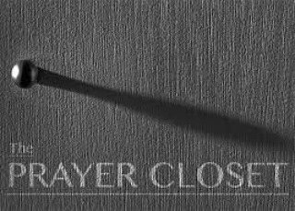
一。祷告的地方。1. Praying places.
(8)
B。私人祷告。在各个私人地方独自祷告。(1)任何地方。“散了众人以后，他就独自上山去祷告。到了晚上，只有祂一人在那里”(太14:23)。(2) 在暗中的地方。“你祷告的时候，要进你的内屋，关上门，祷告你在暗中的父，你父在暗中察看，必然报答你”(太6:6)。(3) 在床上。“我在床上记念你，在夜更的时候思想你”(诗63:6)。
B. Private praying. Pray alone in various private places. (1) Anywhere. “After he had dismissed them, he went up on a mountainside by himself to pray. Later that night,he was there alone”(Mt.14:23).(2) In secret place. “But when you pray, go into your room, close the door and
pray to your Father, who is unseen.
Then your Father, who sees what is
done in secret,will reward you”(Mt.6:6).
(3) In bed. “On my bed I remember
you; I think of you through the watches
of the night”(Ps.63:6).

Slide 12
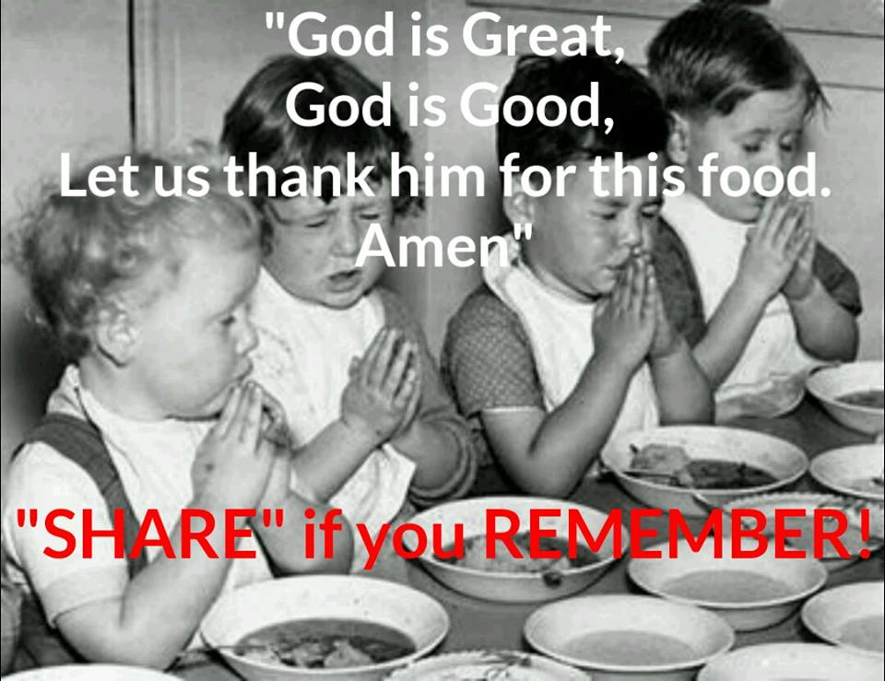
二。祷告时间。2. Praying times.
(9)
“约在半夜，保罗和西拉，祷告唱诗赞美神…”（16:25a）。
A。用餐时间。“就拿着这五个饼，两条鱼，望着天，祝福，掰开饼，递给门徒。门徒又递给众人”（太14:19；15:36）。
B。早上时间。 “早晨我必向你陈明我的心意，并要儆醒”(诗5:3)。 “次日早晨，天未亮的时候，耶稣起来，到旷野地方去，在那里祷告”(可1:35)。
“About midnight Paul and Silas were praying…”
(16:25a).
A. Meal times. “He gave thanks and broke the loaves. Then he gave them to the disciples and the disciples gave them to the people”(Mt.14:19;15:36).
B. Morning time. “In the morning, Lord, you hear my voice; in the morning I lay my requests before you and wait expectantly”(Ps.5:3).“Very early in the morning,while it was still dark,Jesus got up, left the house and went off to a solitary place, where he prayed” (Mk.1:35).

Slide 13
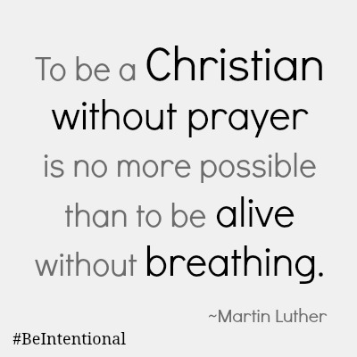
(10)
二。祷告时间。2. Praying times.
C。固定时间。 “我要晚上，早晨，晌午，哀声悲叹。他也必听我的声音”(诗55:17；但6:10)。
D。任何时间。“耶稣设一个比喻，是要人常常祷告，不可灰心”
(路18:1)。“在祷告之间，常常恳求”(罗1:10)“不住地祷告”(帖前5:17)。
E。紧急时刻。“只因见风甚大，就害怕。将要沉下去，便喊着说，主阿，救我” (太14:30)。
不祷告而做基督徒和不呼吸而活着一样不可能。
C. Fixed times. “Evening,morning and noon
I cry out in distress, and he hears my voice”
(Ps.55:17; Dan.6:10).
D. All times. “Then Jesus told his disciples a
parable to show them that they should always
pray and not give up”(Lk.18:1).“In my prayers
at all times”(Ro.1:10). “Prayer continually”
(1Thes.5:17).
E. Emergency times. “But when he saw the
wind, he was afraid and, beginning to sink,
cried out, “Lord, save me!”(Mt.14:30).

Slide 14
(11)
三。祷告的人。3. Praying people.
“这些人，同着几个妇人，和耶稣的母亲马利亚，并耶稣的弟兄，都同心合意地恒切祷告”(徒1:14；21:5)
A。男人。“我愿男人无忿怒，无争论，（争论或作疑惑），举起圣洁的手，随处祷告”(提前2:8)。(1) 领导者。“保罗和西拉，祷告”(徒16:25)。 (2) 失败者。“禁卒一醒，看见监门全开，以为囚犯已经逃走，就拔刀要自杀。保罗大声呼叫说，不要伤害自己，我们都在这里。禁卒叫人拿灯来，就跳进去，战战兢兢地俯伏在保罗西拉面前。又领他们出来说，二位先生，我当怎样行才可以得救？”(16:27-30)。
“They all joined together constantly in prayer, along with the women and Mary the mother of Jesus, and with his brothers” (Ac.1:14;21:5).
A. Men. “Therefore I want the men everywhere to pray”(1Ti.2:8). (1) Leaders. “Paul and Silas were praying”(Ac.16:25). (2) Losers. “The jailer woke up, and when he saw the prison doors open, he drew his sword and was about to kill himself because he thought the prisoners had escaped. But Paul shouted, “Don’t harm yourself! We are all here!” The jailer called for lights, rushed in and fell trembling before Paul and Silas.He then brought them out and asked, “Sirs, what must I do to be saved?”(16:27-30).

Slide 15
(12)
三。祷告的人。3. Praying people.
B。女人。“我们就坐下对那聚会的妇女讲道”(16:13)。(1) 敬拜神的人。“有一个卖紫色布疋的妇人，名叫吕底亚，是推雅推喇城的人，素来敬拜神。她听见了，主就开导她的心，叫她留心听保罗所讲的话。她和她一家，既领了洗，便求我们说，你们若以为我是真信主的，（或作你们若以为我是忠心事主的）请到我家里来住。于是强留我们”(16:14-15)。 (2)被巫鬼附着的人。“有一个使女迎着面来，她被巫鬼所附，用法术，叫她主人们大得财利。她跟随保罗和我们，喊着说，这些人是至高神的仆人，对你们传说救人的道。她一连多日这样喊叫，保罗就心中厌烦，转身对那鬼说，我奉耶稣基督的名，吩咐你从她身上出来。那鬼当时就出来了”(16:16-18)。
B. Women. “We sat down and began to speak to the women who had gathered there”(16:13). (1) God worshiper. “One of those listening was a woman from the city of Thyatira named Lydia, a dealer in purple cloth. She was a worshiper of God. The Lord opened her heart to respond to Paul’s message. When she and the members of her household were baptized, she invited us to her home. “If you consider me a believer in the Lord”(16:14-15). (2) Demon possessed. “We were met by a female slave who had a spirit by which she predicted the future. She earned a great deal of money for her owners by fortune-telling. She followed Paul and the rest of us, shouting, “These men are servants of the Most High God, who are telling you the way to be saved.” She kept this up for many days. Finally Paul became so annoyed that he turned around and said to the spirit, “In the name of Jesus Christ I command you to come out of her!” At that moment the spirit left her”(16:16-18).

Slide 16
(13)
四。祷告的元素。4. Praying elements.
“应当一无挂虑，只要凡事借着祷告，祈求，和感谢，将你们所要的告诉神”(腓4:6)。
A。崇拜。“耶和华阿，尊大，能力，荣耀，强胜，威严都是你的。凡天上地下的都是你的。国度也是你的，并且你为至高，为万有之首。丰富尊荣都从你而来，你也治理万物。在你手里有大能大力，使人尊大强盛都出于你”(代上29:11-12)。
B。承认。“我们若认自己的罪，神是信实的，是公义的，必要赦免我们的罪，洗净我们一切的不义”(约一1:9)。
“Do not be anxious about anything, but in every situation, by prayer and petition, with thanksgiving, present your requests to God”(Phil.4:6).
A=Adoration. “Yours, Lord, is the greatness and the power and the glory and the majesty and the splendor, for everything in heaven and earth is yours. Yours, Lord, is the kingdom; you are exalted as head over all. Wealth and honor come from you; you are the ruler of all things. In your hands are strength and power to exalt and give strength to all”(1 Chron.29:11-12).
C=Confession. “If we confess our sins, he is faithful and just and will forgive us our sins”(1Jn.1:9).

Slide 17
(14)
四。祷告的元素。4. Praying elements.
C。感谢。 “我每逢想念你们，就感谢我的神。（每逢为你们众人祈求的时候，常是欢欢喜喜地祈求）”(腓1:3-4，25；2:2，29:4:1)。即使在监狱里，保罗欢喜(1:18; 2:17,18; 3:1; 4:4,10)。
D。祈求。“我劝你第一要为万人恳求祷告，代求，祝谢。为君王和一切在位的也该如此。使我们可以敬虔端正，平安无事的度日”(提前2:1-2)。“我所祷告的，就是要你们的爱心，在知识和各样见识上，多而又多”(腓1:9)。
T=Thanksgiving. “I thank my God every time I remember you, In all my prayers for all of you, I always pray with joy”(Phil.1:3-4,25; 2:2,29;4:1). Even in Prison, Paul rejoiced (1:18;2:17,18;3:1;4:4,10).
S=Supplication.“I urge,then,first of all,that
petitions,prayers,intercession and thanks-
giving be made for all people-for kings and
all those in authority,that we may live peace-
ful and quiet lives in all godliness and holi-
ness”(1Ti.2:1-2).“This is my prayer:that your
love may abound more and more”(Phil.1:9).

Slide 18
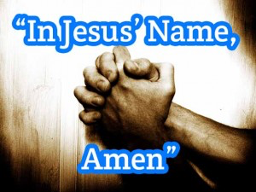
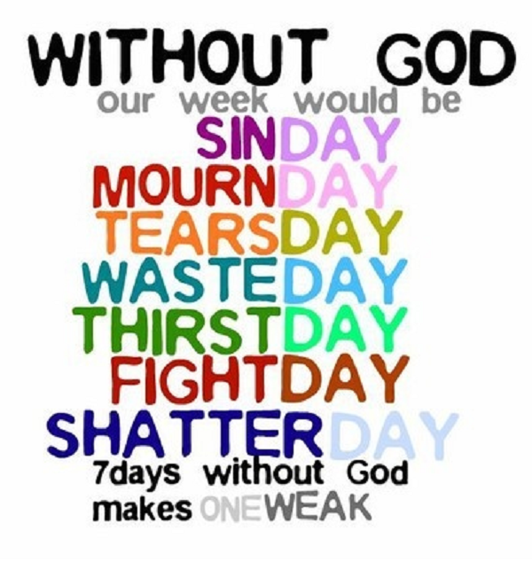
(15)
五。祷告的应许。5. Praying promises.
神的应许和话语可以成为我们的祷告。
A。奉耶稣的名。“你们奉我的名，无论求什么，我必成就，叫父因儿子得荣耀。你们若奉我的名求什么，我必成就”(约14:13-14)。
God promises and words can become our prayers.
A. Ask in Jesus’s name. “And I will do whatever you ask in my name, so that the Father may be glorified in the Son. You may ask me for anything in my name, and I will do it”(Jn.14:13-14).

Slide 19
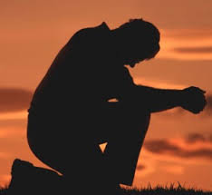
(16)
五。祷告的应许。5. Praying promises.
B。照祂的旨意求。 “我们若照祂的旨意求什么，祂就听我们。这是我们向祂所存坦然无惧的心。既然知道祂听我们一切所求的，就知道我们所求于祂的无不得着”(约一5:14-15)。
C。使你们一切所需用的都充足。 “我的神必照祂荣耀的丰富，在基督耶稣里，使你们一切所需用的都充足”(腓4:19)。
B. Ask according to God’s will. “This is the confidence we have in approaching God: that if we ask anything according to his will, he hears us. And if we know that he hears us—whatever we ask—we know that we have what we asked of him”(1Jn.5:14-15).
C. Provide for all our needs. “And my God will
meet all your needs according to the riches of his
glory in Christ Jesus”(Phil.4:19).

Slide 20
(17)
结论：Conclusion:
神怎么回答我们的祷告？ 有时祂立刻回答。“就说，耶稣阿，你得国降临的时候，求你记念我。耶稣对他说，我实在告诉你，今日你要同我在乐园里了”(路23:42-43)。有时祂迟一点回答。“说，某城里有一个官，不惧怕神，也不尊重世人。那城里有个寡妇，常到他那里，说，我有一个对头，求你给我伸冤。他多日不准。后来心里说，我虽不惧怕神，也不尊重世人。只因这寡妇烦扰我，我就给她伸冤吧。免得她常来缠磨我。主说，你们听这不义之官所说的话。神的选民，昼夜呼吁祂，祂纵然为他们忍了多时，岂不终久给他们伸冤吗？”(18:2-7)。
How does God answer our prayers? Sometimes He answers immediately. “Then he said, “Jesus, remember me when you come into your kingdom.”Jesus answered him,“Truly I tell you,today you will be with me in paradise”(Lk23:42-43). Sometimes He answers after a delay. “He said: “In a certain town there was a judge who neither feared God nor cared what people thought. And there was a widow in that town who kept coming to him with the plea, ‘Grant me justice against my adversary.’ “For some time he refused. But finally he said to himself, ‘Even though I don’t fear God or care what people think,yet because this widow keeps bothering me, I will see that she gets justice,so that she won’t eventually come and attack me!’” And the Lord
said, “Listen to what the unjust judge says. And will not God bring about justice for his chosen ones, who cry out to him day and night? Will he keep putting them off?”(18:2-7).

Slide 21
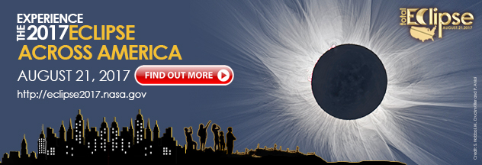
(18)
结论：Conclusion:
有时比我们所求的给得更多。 “神能照着运行在我们心里的大力，充充足足的成就一切超过我们所求所想的”(弗3:20)。有时不同于我们的祈求(林后12:7-9)有时神说“不”(撒下12:15-20)。有时神要我们行动(尼4:9)。 祷告的教会是一个有力量而有功效的教会。 你是一个有力量而有功效祷告的基督徒吗？ 我们是一个有力量而有功效祷告的教会吗？“我若心里注重罪孽，主必不听”(诗66:18)。心里注重罪孽，就像日食。
Sometimes more than asked for. “Now to him who is able to do immeasurably more than all we ask or imagine, according to his power that is at work within us”(Eph.3:20).Sometimes different from the request(2Co.12:7-9).Sometimes God says “No”(2Sam.12:15-20).Sometimes God requires action on our part (Neh.4:9). A praying church is a powerful and effective church. Are you a powerful and effective praying Christian? Are we a powerful and effective praying Church? ”If I had cherished sin in my heart, the Lord would not have listened”(Ps.66:18). To cherish sin in my heart,
is like a solar eclipse.

