Slide 1
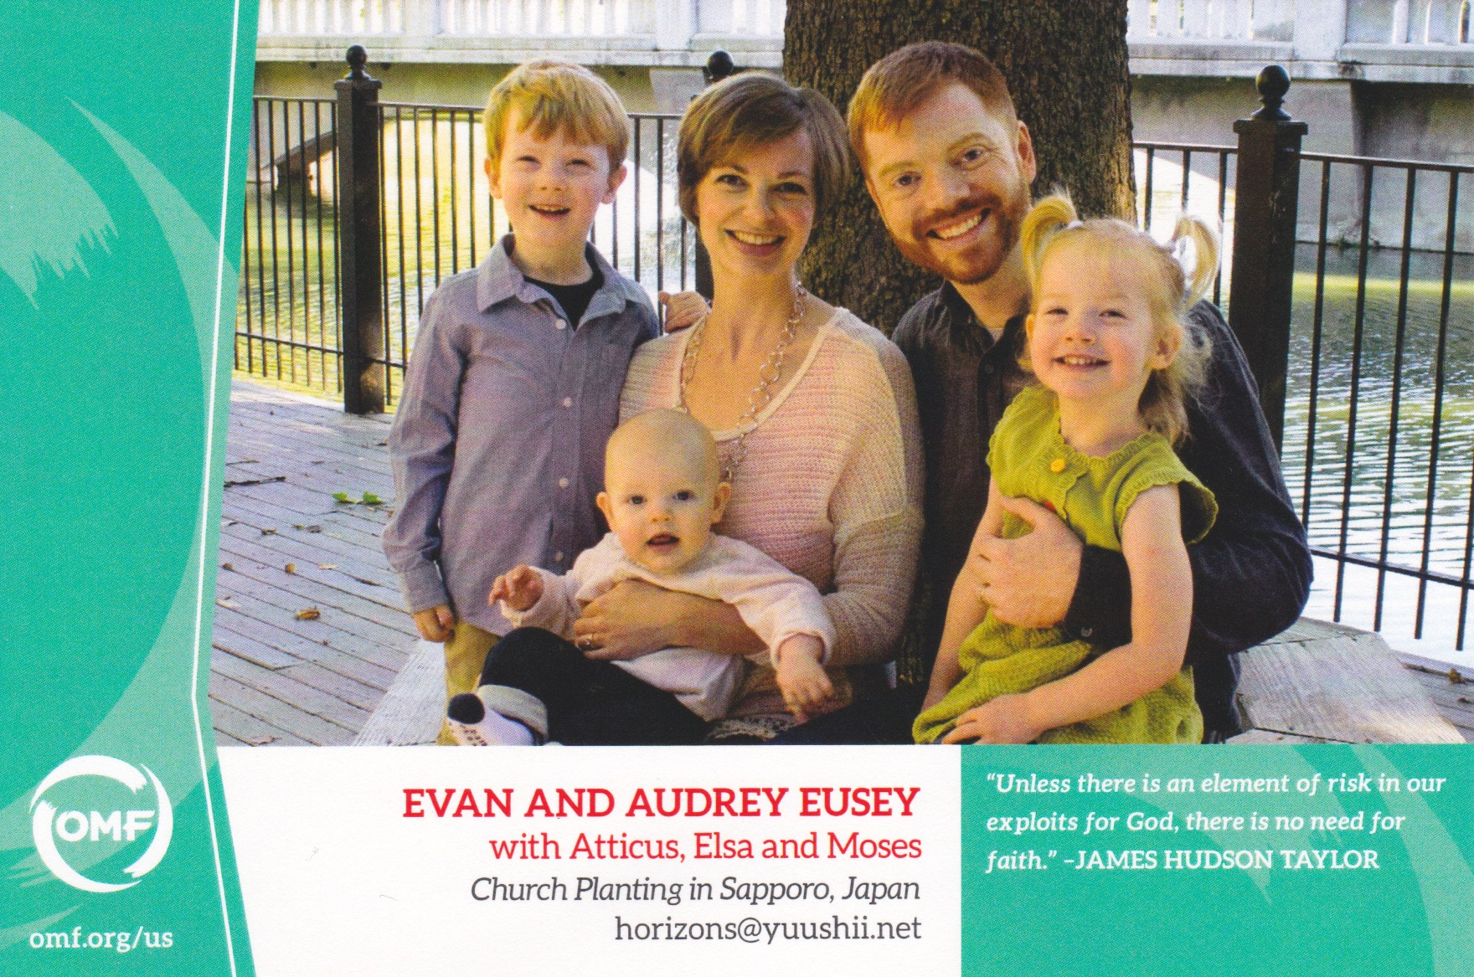

Slide 2
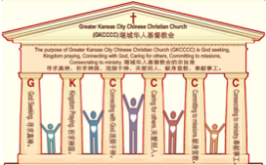
主日:二零一七年八月十三日
Sunday: August 13, 2017
何礼义牧师 Pastor Gary Hart
题目：“有异象的教会。”
Topic: “Visionary Church.”
经文:徒16:1-11 Text: Acts 16:1-11
“在夜间有异象现与保罗…” (徒16:9)。
“During the night Paul had a vision…”(16:9).
(1)

Slide 3
引言:A。使徒行传的信息。 Intro: A.Message of Acts of the Apostles.
(2)
(一)基督建造祂的教会（基督的灵借着使徒在作工）。
(二)使徒行传是圣灵的指挥,控制和赋权的事工,创立和加强了教会，并使它成长。
(三)使徒行传是一个过渡时期:从耶稣的事工到使徒的;从旧约到新约;从以色列作神的见证到教会作神的见证;从犹太教出来, 教会诞生了。
(四)使徒行传显示大使命得以遵行(1:8)从证人到耶路撒冷(1-8),到犹太和撒玛利亚(8-12)并到地极(13-28)。
(五)保罗开始了他的第二次宣教旅程。
(1)Christ builds His Church(the Acts of the Spirit of Christ through the Apostles). (2)The Acts were the Spirit’s directing, controlling, and empowering ministry that founded and strengthened the church and caused it to grow.
(3)The Acts is a time of transitions: from ministry of Jesus to that of the apostles; from the Old Covenant to the New Covenant; from Israel as God’s witness to the Church as God’s witness; from Judaism is going out and Church is coming in.
(4)The Acts show the fulfillment of the Great Commission(1:8) from the witness to Jerusalem(1-8), to Judea and Samaria(8-12), and to the ends of earth(13-28).
(5) Paul began his second missionary journey.

Slide 4
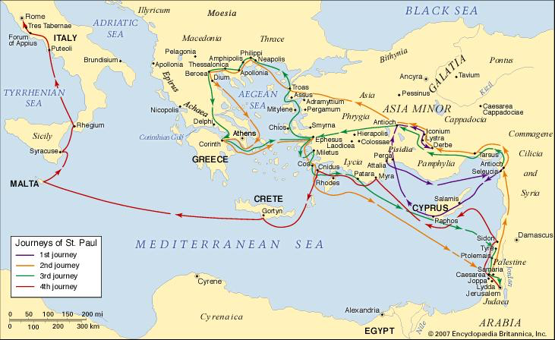
B。尼亚波利地理位置。B. Neapolis location.
(3)

Slide 5
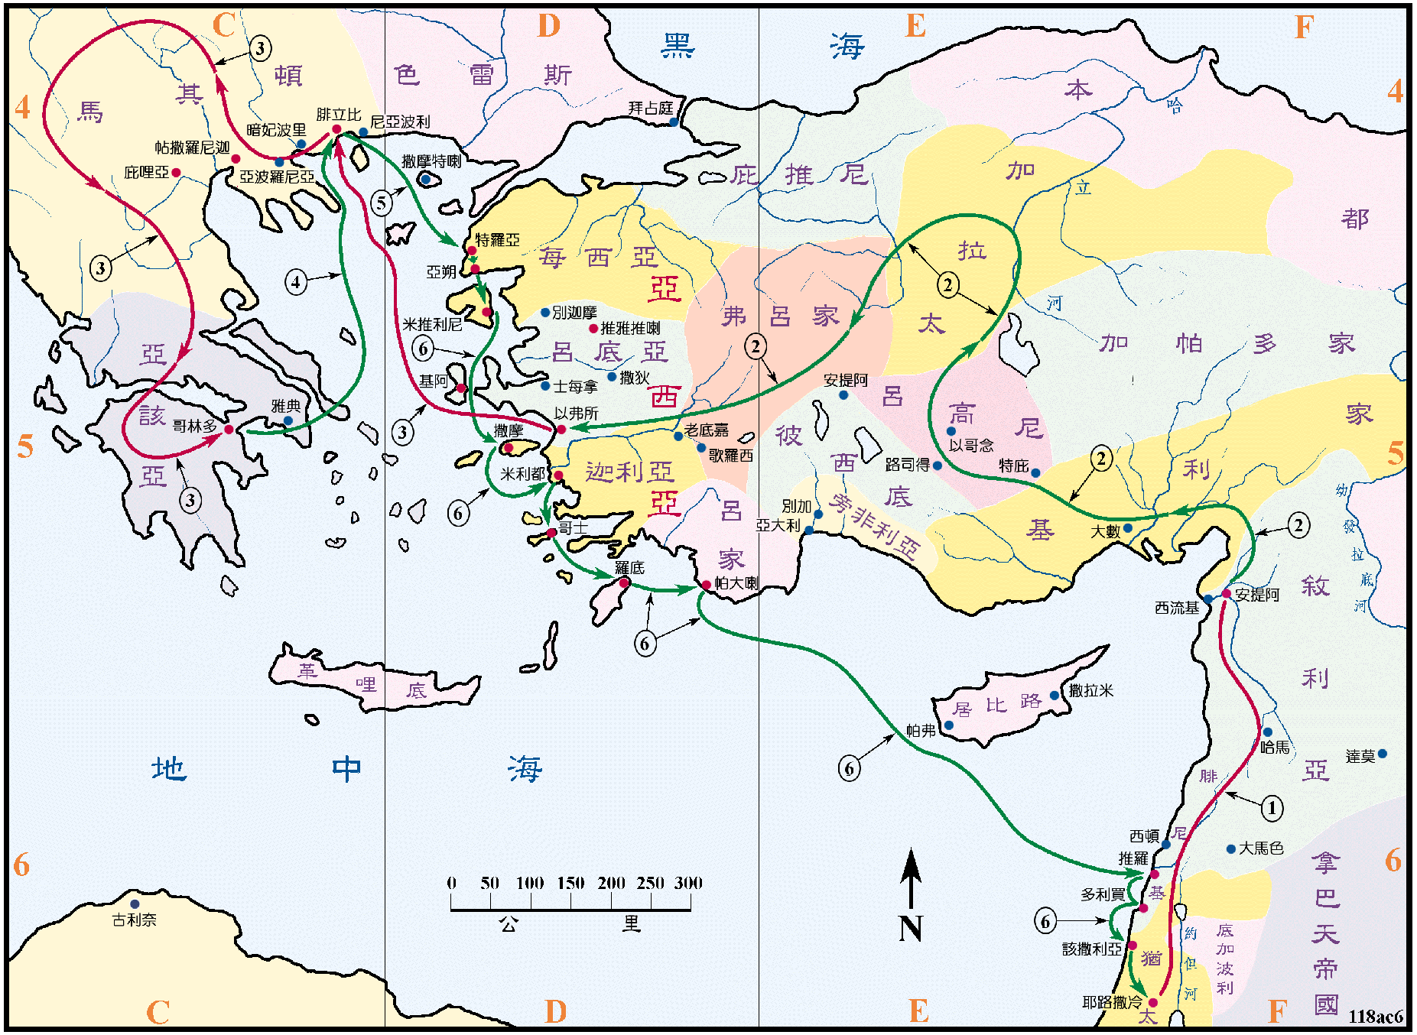
B。尼亚波利地理位置。B. Neapolis location.
(4)

Slide 6
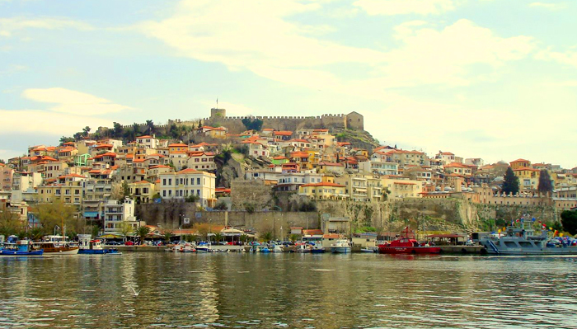
C。尼亚波利的历史背景。C.Neapolis historical background.
(1)尼亚波利是腓立比的一个港口城市（16:11），距离马其顿北部的腓立比约十公里。
(2)尼亚波利的教会是由保罗创立的。
(3)尼亚波利的教会代表“有异象的教会”。
(4)尼亚波利的意思是“新城市”。 只要有福音的大门敞开，保罗就永远不会安定在任何有“舒适的事工”的地方。 这里一个新城市带来了新的合作伙伴，新的帮手，新的异象，新的使命和新的方向。
(1) Neapolis was the seaport of Philippi(16:11) about 10 miles from Philippi in NE Macedonia.
(2) Neapolis church was founded by Paul.
(3) Neapolis church represents “Visionary Church”.
(4) Neapolis means“new city”.Paul could never
settle down to a“comfortable ministry”anywhere
as long as there were open doors for the
gospel. Here a new city brings a new partner,
a new helper, a new vision, a new mission, and
a new direction.
(5)

Slide 7
(6)
一。新的合作伙伴。1. A new partner.
“过了些日子，保罗对巴拿巴说，我们可以回到从前宣传主道的各城，看望弟兄们景况如何。”（15:36）。
A。保罗和巴拿巴相同，他们对第二次宣教旅行的重要性认识一致。
B。保罗和巴拿巴不同意见，他们对谁应该在宣教队伍意见不一致。(1)巴拿巴的建议。 “巴拿巴有意，要带称呼马可的约翰同去”(15:
37; 西4:10)。(2)保罗的建议。“但保罗，因为马可从前在旁非利亚离开他们，不和他们同去作工，就以为不可带他去”(15:38;13:13)。
“Some time later Paul said to Barnabas, “Let us go back and visit the believers in all the towns where we preached the word of the Lord and see how they are doing”(15:36).
A. Paul and Barnabas agreed. They both agreed on the importance of the second missionary trip.
B. Paul and Barnabas disagreed. They did not agree on who should be on the mission team. (1) Barnabas’s suggestion. “Barnabas wanted to take John, also called Mark, with them”(15:37;Col.4:10). (2) Paul’s suggestion. “But Paul did not think it wise to take him, because he had deserted them in Pamphylia and had not continued with them in the work”(15:38;13:13).

Slide 8
一。新的合作伙伴。1. A new partner.
(7)
C。保罗和巴拿巴接受彼此可以持有不同的意见。你可以同意，不同意或接受彼此持有异议，但总是要有和平的精神。(1)争论：“于是二人起了争论，甚至彼此分开。巴拿巴带着马可，坐船往居比路去。保罗拣选了西拉，也出去”(15:39-40a)。 谁是对的？ 也许两个人都在某些事情上是正确的，而在其他事情上是错误的。 保罗看人会问，“他们能为神的工作做些什么呢？”而巴拿巴看人会问，“神的工作能为他们做什么？”(2)称赞：“蒙弟兄们把他交于主的恩中。他就走遍叙利亚，基利家，坚固众教会”(15:40b-41)。
C. Paul and Barnabas agree to disagree. You can agree, disagree, or agree to disagree, but always have a peaceable spirit.(1) Contention: “They had such a sharp disagreement that they parted company. Barnabas took Mark and sailed for Cyprus, but Paul chose Silas and left”(15:39-40a). Who was right? Perhaps both men were right on some things and wrong on other things. Paul looked at people and asked, “What can they do for God’s work?” while Barnabas looked at people and asked, “What can God’s work do for them?” (2)Commendation: “Commended by the believers to the grace of the Lord. He went through Syria and Cilicia, strengthening the churches”(15:40b-41).

Slide 9
二。新的帮手。2. A new helper.
(8)
“保罗来到特庇，又到路司得。在那里有一个门徒，名叫提摩太…”（16:1a）。
A。提摩太被教导神的道。“是信主之犹太妇人的儿子，他父亲却是希利尼人”（16:1b）。提摩太是母亲(友尼基)和祖母(罗以)给他起的名，意思是“荣耀神的人”。她们是虔诚的犹太人成为信徒在主耶稣基督里(提后1:5)。 从提摩太小时候就教导他圣经(提后3:15)。
B。提摩太是保罗带领认识基督的。 “我真儿子”(提前1:2,18;林前4:17;提后1:2)。
“Paul came to Derbe and then to Lystra,where a disciple named Timothy lived…” (16:1a).
A. Timothy was taught the Word. “Whose mother was Jewish and a believer but whose father was a Greek”(16:1b). Timothy received his name, which means “one who honors God,” from his mother (Eunice) and grandmother (Lois), devout Jews who became believers in the Lord Jesus Christ(2Tim. 1:5). They taught Timothy the OT Scriptures from his childhood (2Tim. 3:15).
B. Timothy was lead to Christ by Paul. “My true son in the faith(1Tim.1:2,18; 1Cor.4:17;2Tim.1:2).

Slide 10
二。新的帮手。2. A new helper.
(9)
C。提摩太是受保罗的教导。 “你在许多见证人面前听见我所教训的，也要交托那忠心能教导别人的人”（提后2:2)。“路司得和以哥念的弟兄，都称赞他”(徒16:2)。
D。提摩太受过割礼。“保罗要带他同去，只因那些地方的犹太人，都知道他父亲是希利尼人，就给他行了割礼”(16:3)。(1)耶路撒冷会议的决定是得救不需要受割礼(15:11)。 (2)提多决定不受割礼，免得敌人认为他认同他們的主張 (加2:1-5)。 (3)提摩太决定为了他的服事受割礼。 因他会和犹太人和外邦人一起工作(林前9:19-23)。
C. Timothy was discipled by Paul. “And the things you have heard me say in the presence of many witnesses entrust to reliable people who will also be qualified to teach others”(2Tim.2:2). “The believers at Lystra and Iconium spoke well of him”(Ac.16:2).
D. Timothy was circumcised. “Paul wanted to take him along on the journey, so he circumcised him because of the Jews who lived in that area, for they all knew that his father was a Greek”(16:3). (1) The decision at the Jerusalem Conference was that it was not necessary to be circumcised in order to the saved(15:11). (2) The decision for Titus was not to be circumcised lest the enemy think that he was promoting their cause (Gal.2:1-5). (3) The decision for Timothy to be to be circumcised for his service. He would be working with both Jews and Gentiles(1Cor.9:19-23).

Slide 11
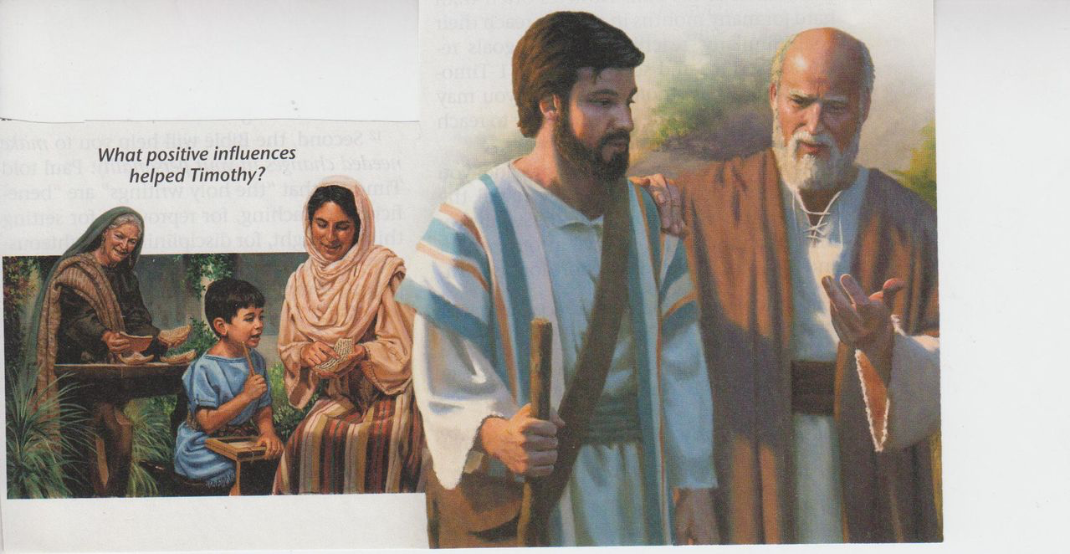
(10)
二。新的帮手。2. A new helper.
E。提摩太是与保罗一起服事的同工。“他们经过各城，把耶路撒冷使徒和长老所定的条规，交给门徒遵守。于是众教会信心越发坚固，人数天天加增”(16:4-5;17:14,15; 18:5; 20:4)。
E. Timothy was a co-laborer who ministered with Paul. “As they traveled from town to town, they delivered the decisions reached by the apostles and elders in Jerusalem for the people to obey. So the churches were strengthened in the faith and grew daily in numbers” (16:4-5;17:14,15;18:5;20:4).

Slide 12
三。新的异象。3. A new vision.
“义人的脚步，被耶和华立定…”(诗37:
23)和我们的停步。 神打开门和关闭门。
A。闭门。“圣灵既然禁止他们在亚西亚讲道，他们就经过弗吕家，加拉太一带地方。到了每西亚的边界，他们想要往庇推尼去，耶稣的灵却不许”(16:6-7)。(1)保罗试图向东进入亚细亚和庇推尼，為主的福音进入新地方，但主关上门。 (2)保罗可能感到失望，也许有点气馁。(3)神计划在另一个时间使福音进入那里(18:19-19:41)。
“The Lord makes firm the steps…” (Ps.37:23) and our stops. God opens and closes doors.
A. Closed doors. “Paul and his companions traveled throughout the region of Phrygia and Galatia, having been kept by the Holy Spirit from preaching the word in the province of Asia.When they came to the border of Mysia, they tried to enter Bithynia, but the Spirit of Jesus would not allow them to”(16:6-7). (1) Paul tried to enter new territory for the Lord by traveling east into Asia Minor and Bythinia, but the Lord closed the door. (2) Paul was probably disappointed and perhaps a little discouraged. (3)God planned for the message to get there another time(18:19- 19:41).
(11)

Slide 13
(12)
三。新的异象。3. A new vision.
B。开门。“他们就越过每西亚，下到特罗亚去。在夜间有异象现与保罗。有一个马其顿人，站着求他说，请你过到马其顿来帮助我们。保罗既看见这异象，我们随即想要往马其顿去，以为神召我们传福音给那里的人听。于是从特罗亚开船，一直行到撒摩特喇，第二天到了尼亚波利”(16:8-11)。(1)在特罗亚，保罗被一个在夜间异象中看到的人召到马其顿。(2)写了“使徒行传”的路加医生加入了保罗和他在特罗亚的团队。 使徒行传有三处“我们” :16:10- 17; 20: 5-15;27:1-28:16。“我在你面前给你一个敞开的门”(启3:8)。
B. Open doors. “So they passed by Mysia and went down to Troas. During the night Paul had a vision of a man of Macedonia standing and begging him, “Come over to Macedonia and help us.” After Paul had seen the vision, we got ready at once to leave for Macedonia, concluding that God had called us to preach the gospel to them. From Troas we put out to sea and sailed straight for Samothrace, and the next day we went on to Neapolis.”(16:8-11). (1) At Troas, Paul was called to Macedonia by a man whom he saw in a night vision. (2) Dr. Luke who wrote the book of Acts, joined Paul and his team at Troas. There are 3 “we” sections in Acts:16:10-17;20:5-15;27:1-28:16. “I have set before you an open door”(Re.3:8).

Slide 14
(13)
在走廊里赞美祂，直到神打开下一扇门
神开的门是无人能关的。

Slide 15
(14)
四。新的使命。4. A new mission.
保罗曾有一个使命，但现在他有一个新的使命。
A。保罗的使命。 “犹太人和希利尼人，并没有分别。因为众人同有一位主，他也厚待一切求告他的人。因为凡求告主名的，就必得救。然而人未曾信他，怎能求他呢？未曾听见他，怎能信他呢？没有传道的，怎能听见呢？若没有奉差遣，怎能传道呢？如经上所记，报福音传喜信的人，他们的脚踪何等佳美”（罗10:12-15）
Paul had a mission, but now he has a new mission.
A. Paul’s mission. “For there is no difference between Jew and Gentile—the same Lord is Lord of all and richly blesses all who call on him, for, “Everyone who calls on the name of the Lord will be saved.” How, then, can they call on the one they have not believed in?And how can they believe in the one of whom they have not heard? And how can they hear without someone preaching to them? And how can anyone preach unless they
are sent? As it is written: “How beautiful are the
feet of those who bring good news!”(Ro.10:12-15)

Slide 16
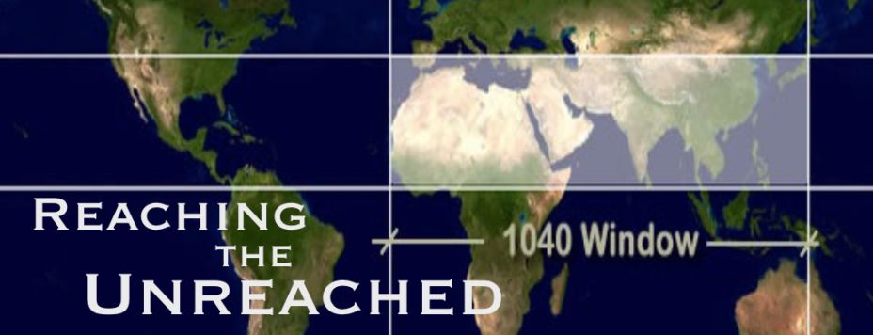
(15)
四。新的使命。4. A new mission.
B。保罗的新使命。“我立了志向，不在基督的名被称过的地方传福音，免得建造在别人的根基上。就如经上所记，未曾闻知他信息的，将要看见。未曾听过的，将要明白”（罗15:20-21）。
B. Paul’s new mission. “It has always been my ambition to preach the gospel where Christ was not known, so that I would not be building on someone else’s foundation. Rather, as it is written: “Those who were not told about him will see, and those who have not heard will understand.” (Ro.15:20-21)
到达未达之地。

Slide 17
(16)
五。新的方向。5. A new direction.
“你的后裔必像地上的尘沙那样多，必向东西南北开展。地上万族必因你和你的后裔得福”（创28:14）。
A。东方。“但圣灵降临在你们身上，你们就必得着能力。并要在耶路撒冷，犹太全地，和撒玛利亚，直到地极，作我的见证”
(徒1:8)。首先，在中东（耶路撒冷，犹太，撒马利亚等），然后到东方（亚洲，小亚细亚）。 使徒多马去了印度然后也许去了中国。教会是西方的还是东方的？ 教会从东方开始，然后传到了西方。
“Your descendants will be like the dust of the earth, and you will spread out to the west and to the east, to the north and to the south. All peoples on earth will be blessed through you and your offspring”(Gen.28:14).
A. Eastern direction. “But you will receive power when the Holy Spirit comes on you;and you will be my witnesses in Jerusalem, and in all Judea and Samaria,
and to the ends of the earth”(Ac.1:8). First, in the Middle East (Jerusalem, Judea, Samaria, etc.), then to the East (Asia, Asia Minor). The Apostle Thomas went to India and then perhaps China. Is it a Western Church or Eastern Church? The church started in the East and then went to the West.

Slide 18
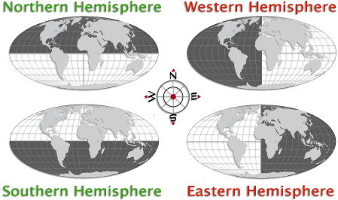
(17)
五。新的方向。5. A new direction.
B。西方。 “我又告诉你们，从东从西，将有许多人来，在天国里与亚伯拉罕，以撒，雅各，一同坐席”（太8:11） 。“从东，从西，从南，从北，将有人来，在神的国里坐席”（路13:29）。
B. Western direction. “I say to you that many will come from the east and the west, and will take their places at the feast with Abraham, Isaac and Jacob in the kingdom of heaven”(Mt.8:11).“People will come from east and west and north and south,and will take their places at the feast in the kingdom of God”(Lk13:29).

Slide 19
(18)
结论：Conclusion:
“在每十个人中有九个人是失丧的人，四分之三的人从未听过，每两个人中有一个听不到，教会继续沉睡。 难道我们认为一定有其他方法吗？ 或者也许我们真的不那么在乎”
(Robertson McQuilkin从他的书【重大的忽略】)。 我们是履行大使命吗？(太28:19-20)还是对使命大忽略？
“In a world in which nine out of every ten people are lost, three out of four have never heard the way out, and one of every two cannot hear, the church sleeps on. Could it be we think there must be some other way? Or perhaps we don’t really care that much”
(Robertson McQuilkin from his book, The Great Omission). Are we fulfilling the Great Commission (Mt.28:19-20) or the Great Omission?

Slide 20
(19)
结论：Conclusion:
我们要去传福音，给人施洗，并教导孩子，青年和成年人吗？我们是否在本地和全球接触过未接触福音的人？ 我们是否作为基督的使者祷告，奉獻，训练，服侍和出去？“若有人在基督里，他就是新造的人，旧事已过，都变成新的了”(林后5:17)。在基督里，你是一个新造的人，你有新的合作伙伴，新的帮手，新的异象，新的使命和新的方向。
Are we going,baptizing,and discipling children,youth,and adults? Are we reaching the unreached both locally and globally? Are we praying, giving, training, serving, and going?“Therefore,if anyone is in Christ, the new creation has come: The old has gone, the new is here!”(2Co.5:17). You are a new creation in Christ with a new partner, a new helper, a new vision, a new mission, and a new direction.

