Slide 1
擘饼聚会
Table of the Lord
2026/07/05
主后二零二六年七月五日
惟耶和华在他的圣殿中。全地的人，都当在他面前肃敬静默。
The Lord is in his holy temple; let all the earth be silent before him.
哈巴谷书 Habakkuk 2:20

Slide 2
出Ex 24:8
摩西将血洒在百姓身上，
说：你看！这是立约的血，
是耶和华按这一切话与你们立约的凭据。
And Moses took the blood
and threw it on the people and said,
“Behold the blood of the covenant
that the LORD has made with you
in accordance with all these words.”

Slide 3
^{马太福音 Matthew 26:26-29}
26 他们吃的时候、耶稣拿起饼来、祝福、就擘开、递给门徒、说、你们拿着吃．这是我的身体。
^{27 又拿起杯来、祝谢了、递给他们、说、你们都喝这个。}
^{28 因为这是我立约的血、为多人流出来、使罪得赦。}
29 但我告诉你们、从今以后、我不再喝这葡萄汁、直到我在我父的国里、同你们喝新的那日子。
²⁶ Now as they were eating, Jesus took bread, and after blessing it broke it and gave it to the disciples, and said, “Take, eat; this is my body.” ²⁷ And he took a cup, and when he had given thanks he gave it to them, saying, “Drink of it, all of you, ²⁸ for this is my blood of the covenant, which is poured out for many for the forgiveness of sins. ²⁹ I tell you I will not drink again of this fruit of the vine until that day when I drink it new with you in my Father's kingdom.”

Slide 4
^{记念主 in remembrance of the Lord}
^{记念主这杯的代价}
^{remember the cost of this cup}
^{记念主这杯的目的}
remember the purpose of this cup

Slide 5
报告Announcement
欢迎新朋友 Welcome
主日敬拜聚会前有主日学 (Sunday School 9:30-10:30AM)
周一晚盼望小组聚会（HOPE Group, 7:30PM）
周三圣达菲公寓查经 （上午十点）
Santa Fe Tower Bible Study (10:00AM)
姐妹祷告会（周三晚 7:00 -7:30 Zoom）
教会祷告会（周三晚 7:30 -9:00 Zoom）
Prayer Meeting (Wednesday 7:30 -9:00 PM, church)
周五团契/查经 Friday Fellowship/Bible Study
  北区 (North)、南区 (South)、寻求组 (Seekers)、青少年父母组(Youth Parents)
  网上聚会详见图书馆Zoom 链接 (Online zoom meetings: QR Codes in library)

Slide 6
报告Announcement
特别事项 Special Items
  下午有七月同工会 coworker meeting this afternoon
  主日学开始新一季《迎接主再来》
  will have new Sunday school season next week
  – waiting for Lord’s coming
清洁服事 (Cleaning Service)
  本主日 (This Sunday):
李天时弟兄家
  下主日 (Next Sunday):
王军弟兄家

Slide 7
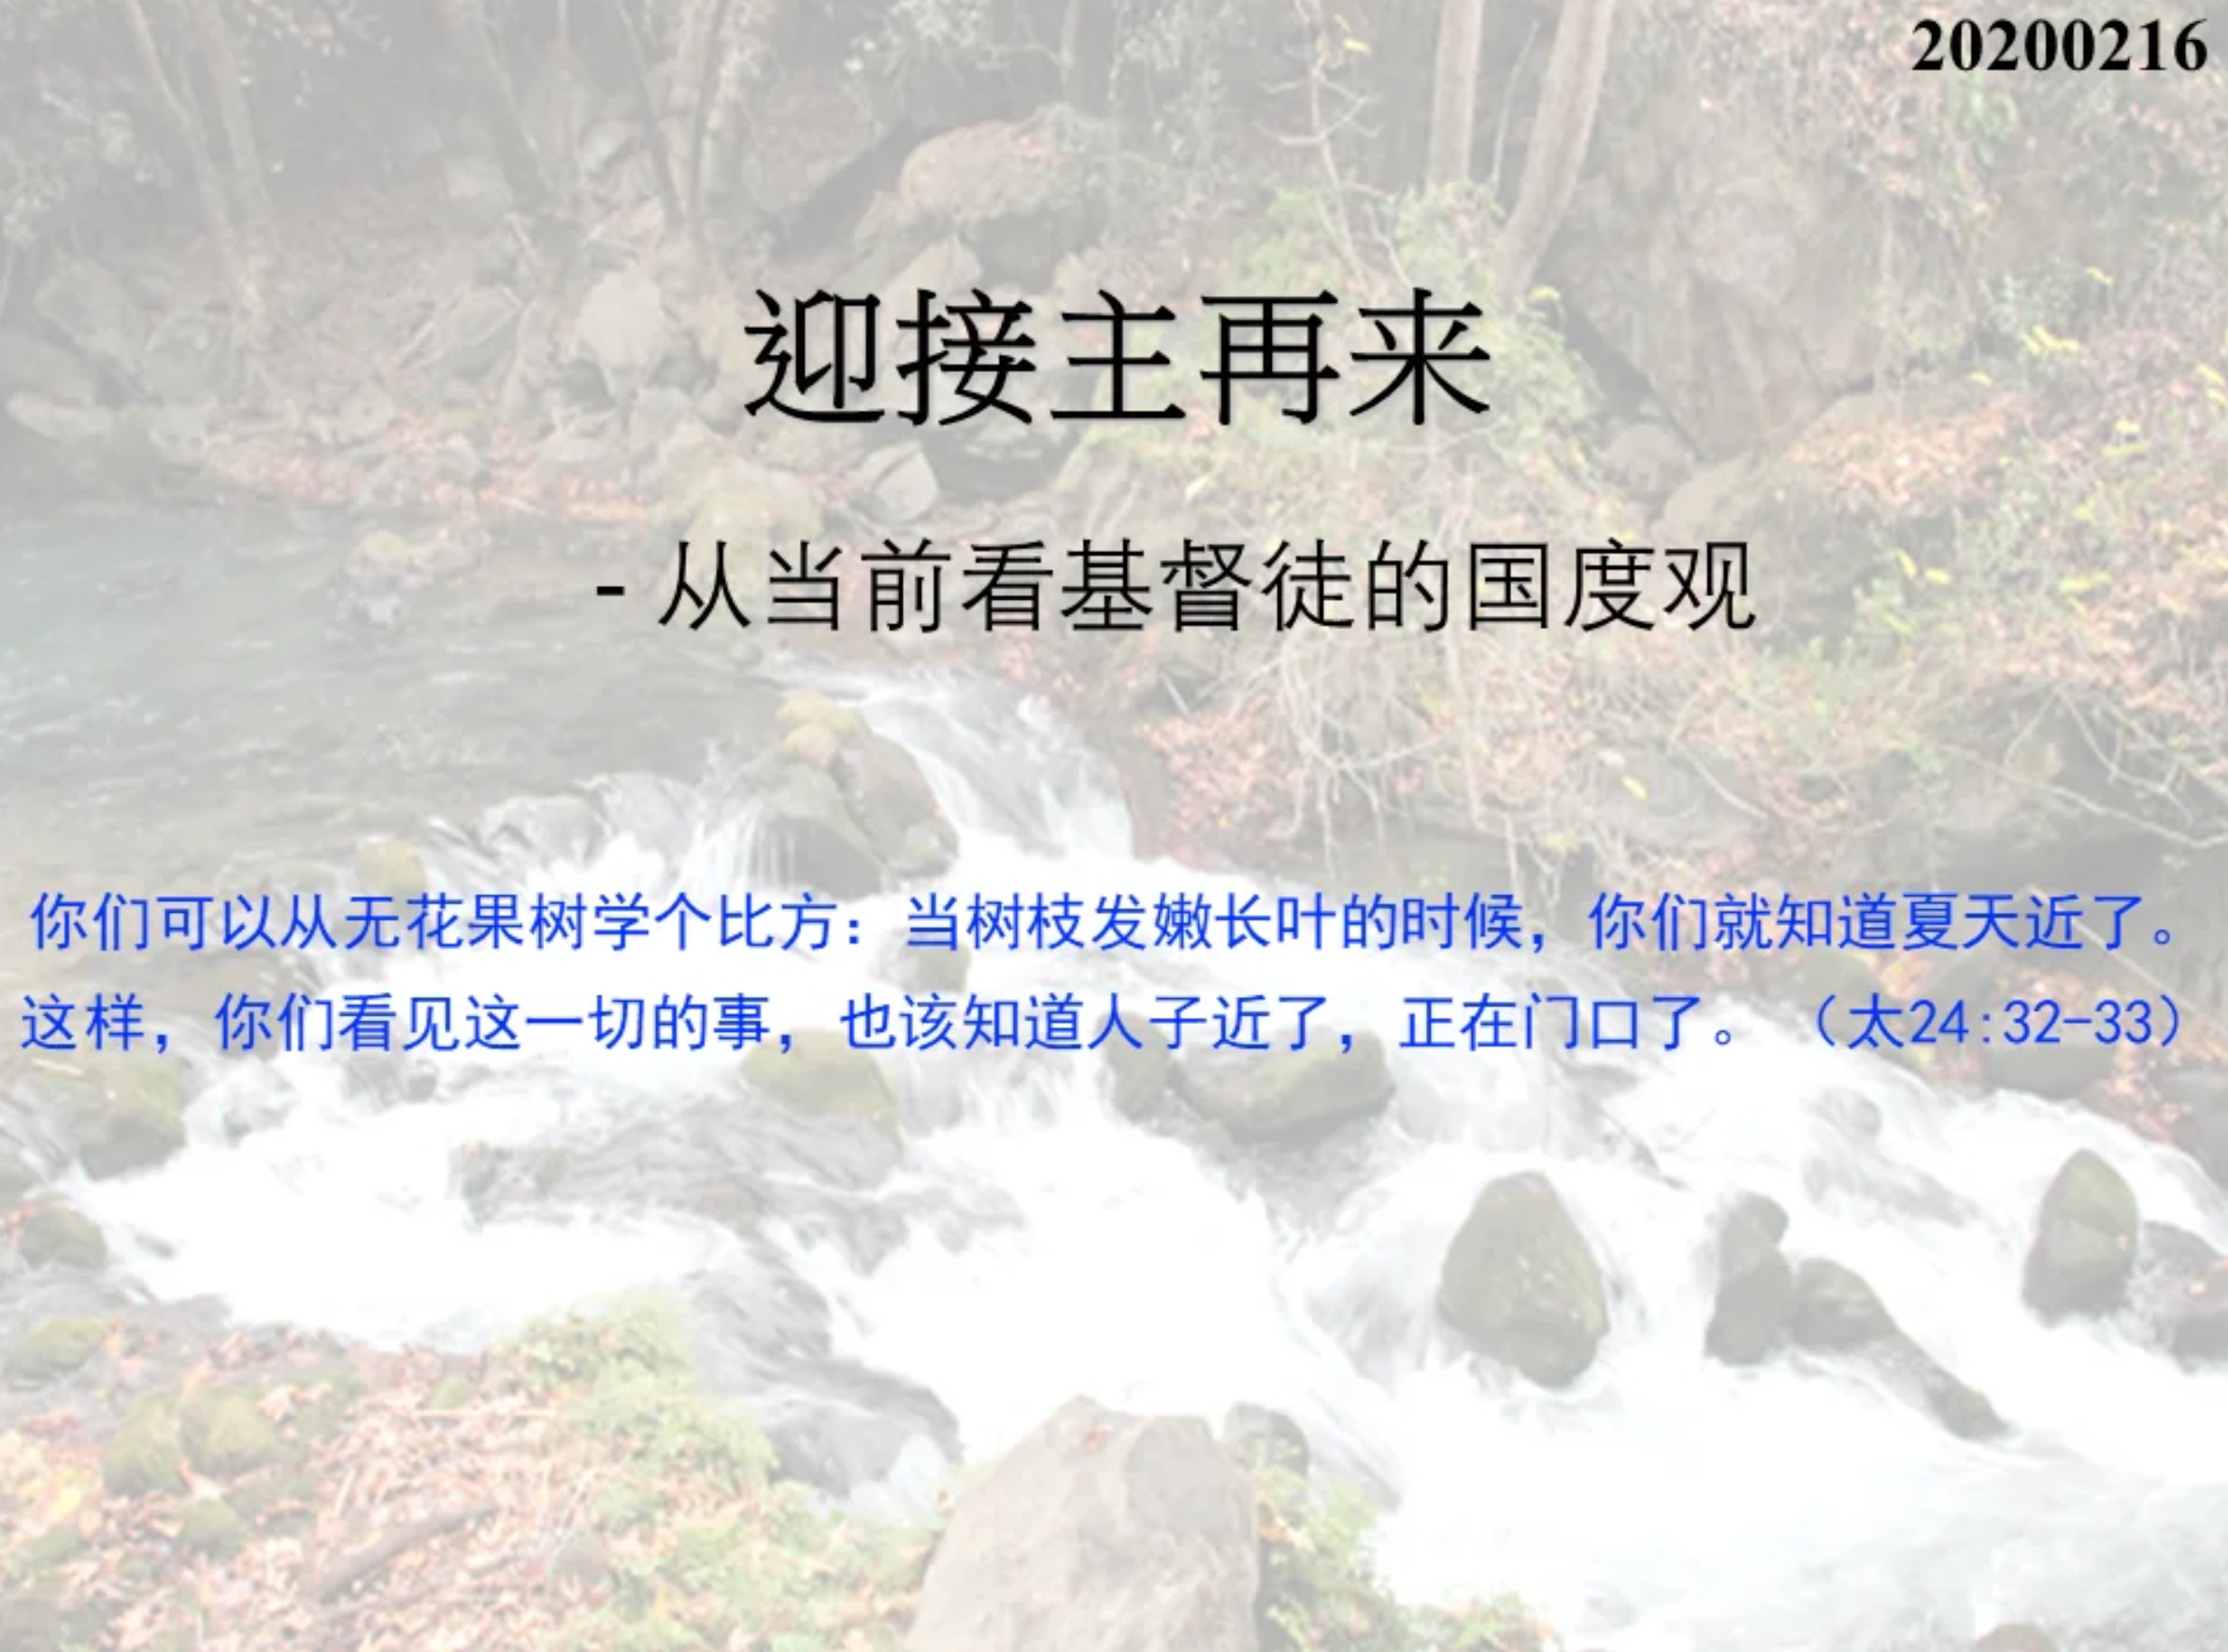

Slide 8
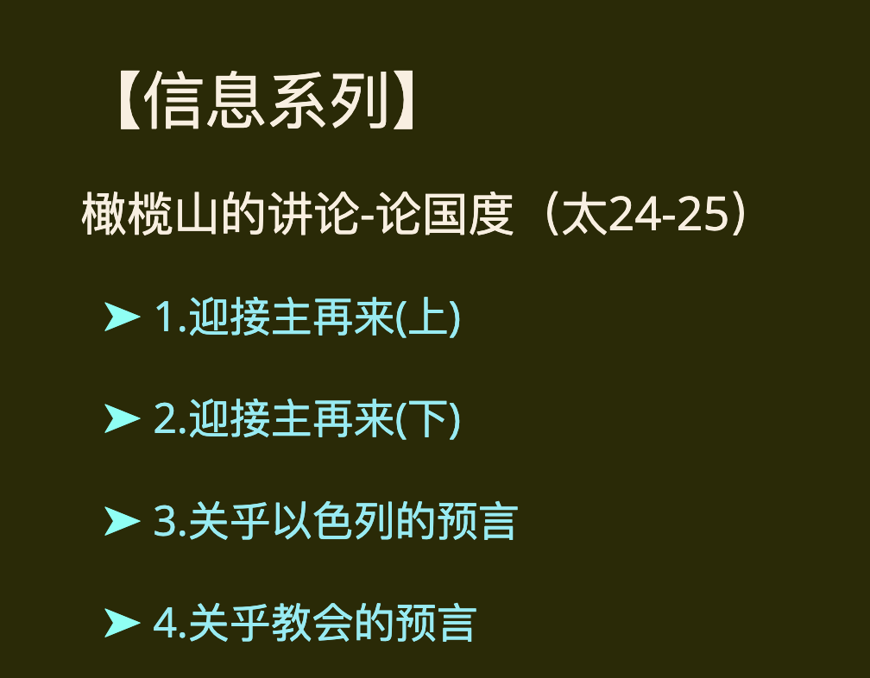
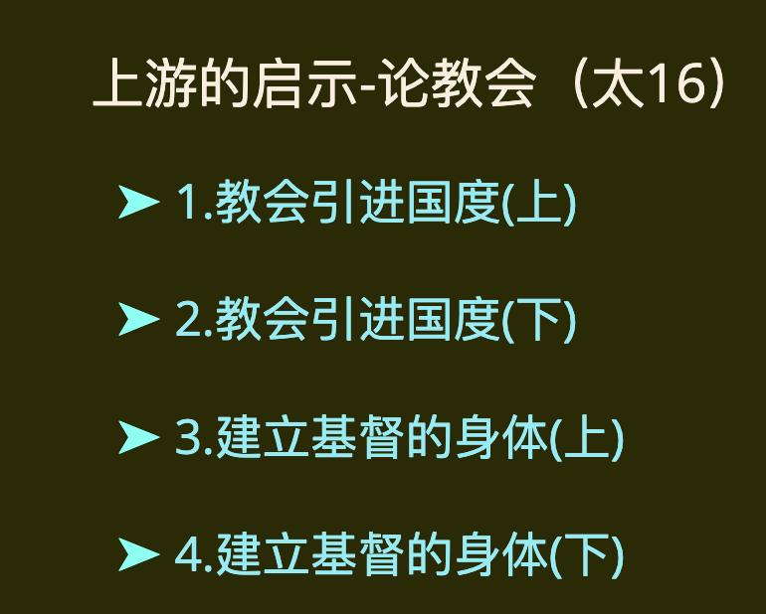
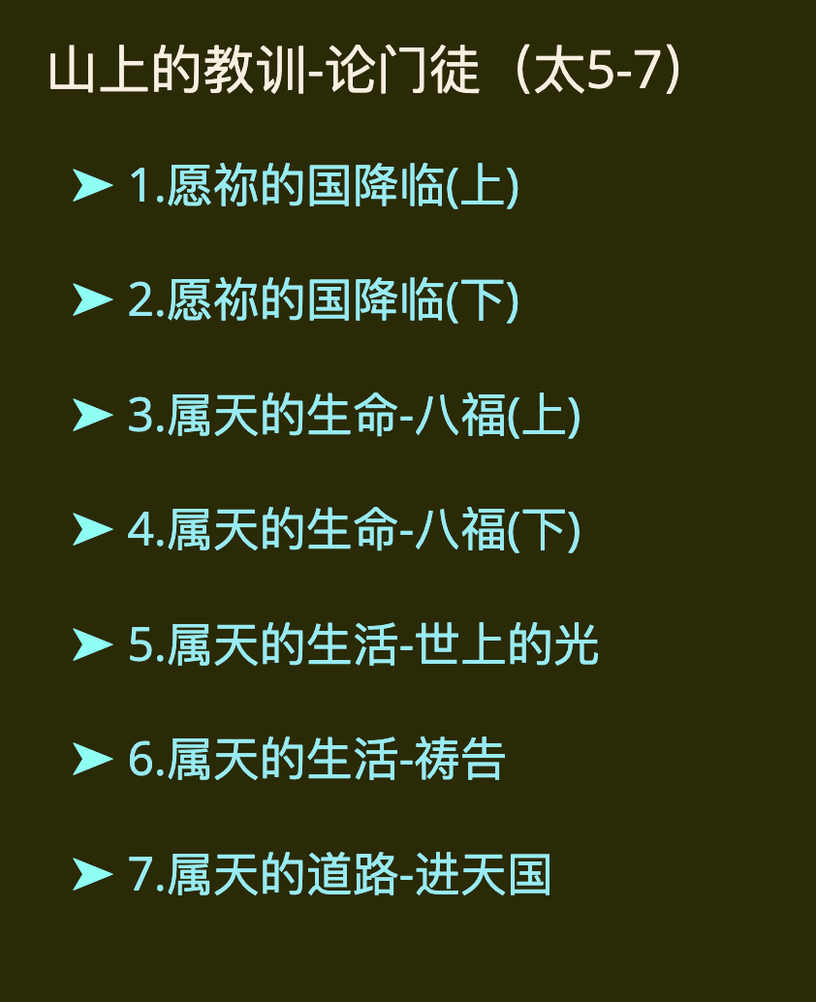

Slide 9
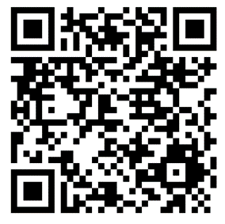
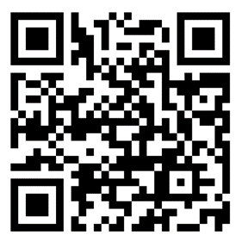
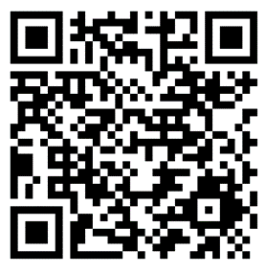
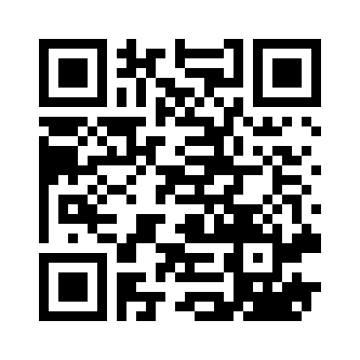
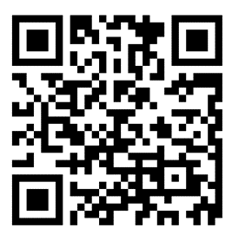
线上聚会链接 QR Codes for Online Meetings
Sunday Service (主日敬拜)
Sunday School (主日学)
Wednesday Prayer (周三祷告会)
North Group (北区团契)
GKCCCC (教会网页)
Hope Group (盼望小组)

